Slide 1
Food and Nutrition Security in Namibia World Health Organization Perspectives
Dr. Mary Nana Ama Brantuo
Medical Officer - World Health Organization

Slide 2
WHO Priorities
STRATEGIC PRIORITY 1:
Advancing Universal Health Coverage (UHC)
STRATEGIC PRIORITY 2:
Addressing Health Emergencies
STRATEGIC PRIORITY 3:
Promoting Healthier Populations
STRATEGIC PRIORITY 4:
Strengthening Leadership, Governance and Enabling Functions
Notes:
Nutrition is critical in each

Slide 3
Importance of Nutrition a critical part of health and development
Better nutrition is related to
safer pregnancy and childbirth,
improved infant, child and maternal health,
lower risk of non-communicable diseases,
stronger immune systems, and longevity
Healthy children learn better: adequate nutrition = more productive
→ opportunities to gradually break the cycles of poverty and hunger.
Malnutrition, in every form = significant threats to human health.
Today’s world faces a double burden of malnutrition that includes both undernutrition and overweight, especially in low- and middle-income countries.

Slide 4
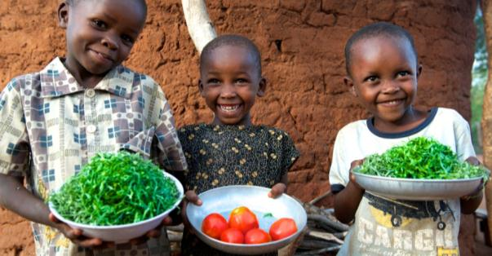
WHO’s Nutrition Mission
To ensure universal access by populations to healthy, safe and sustainable diets as well as effective interventions.
WHO’s ambition for nutrition is to end all forms of malnutrition.

Slide 5
Nutrition Burden: Globally and in the African Region
Globally
Undernutrition has been estimated to contribute up to 45% of child mortality.
For children aged 5–19 years, obesity rates doubled between 2006 and 2016.
Africa is undergoing a nutrition transition
persistent high levels of undernutrition, incl. micronutrient deficiencies
overweight/obesity is increasing in all age groups → additional burden of diet-related noncommunicable diseases.
double burden of malnutrition: individuals, households & populations

Slide 6
WHO’s Response
WHO is providing scientific advice and decision-making tools that can help countries take action to address all forms of malnutrition to support health and wellbeing for all, at all ages.
Global Strategy on Diet, Physical Activity and Health in 2004,
Recommendations on Marketing of Foods and Non-alcoholic Beverages to children (2010)
Comprehensive Implementation Plan on Maternal, Infant and Young Child Nutrition in 2012
Global Action Plan for Prevention and Control of Noncommunicable Diseases: 2013 - 2020
Commission on Ending Childhood Obesity in May 2014, with a set of recommendations to successfully tackle childhood and adolescent obesity in different contexts in 2016,
Nutrient Profile Models to assist countries in identifying foods and non-alcoholic beverages whose marketing should be restricted.

Slide 7
Some Global Nutrition Targets
Comprehensive Implementation Plan on
Maternal, Infant and Young Child Nutrition:
→ Six global targets to be achieved by 2025 / Namibia situation:
reduce number of under-five stunted children by 40% / 24%
reduce anemia in women of reproductive age by 50% / 21%
reduce incidence of low birth weight by 30%; 13%
halt the increase in under-five overweight; 3%
increase rate of exclusive breastfeeding under 6 months to at least 50%; 49%
reduce and maintain under-five wasting below 5% / 6%
The Global Action Plan for the Prevention and Control of Noncommunicable Diseases: 2013 - 2020
halting the rise in diabetes and obesity: 31.4% increasing
30% relative reduction in the intake of salt by 2025

Slide 8
Interventions in Namibia
National Food and Nutrition Security Policy 2020 (2021 - 2031)
Overarching policy and institutional environment
Nutrition sensitive and specific interventions
Scaling Up Nutrition to eliminate all forms of malnutrition
Infant and young children feeding (IYCF) counselling & growth monitoring
Integrated Management of Acute Malnutrition Services
National Multi-Sectoral Non-Communicable Diseases Strategy (2017/18 – 2021/22)

Slide 9
WHO Support to Namibia
Policy Environment
National Regulations for the marketing of breast milk substitutes
Guidance
Management of severe acute malnutrition
Baby Friendly Hospital Guidelines
Capacity Building
Growth assessment according to the WHO Child Growth Standards
Clinical Inpatient Management of Severe Malnutrition
International Code of Marketing of Breast milk Substitutes
Strengthening Nutrition Surveillance
A reviewed set of nutrition indicators for inclusion in national surveys and the health information system.

Slide 10
Areas for Strengthening
Implementation of Food and Nutrition Security Policy and Action Plan
Strengthening Capacity in Health Facilities
Standards and Guidance
Human Resources
Monitoring of Nutrition Indicators
Last Demographic Health Survey (DHS) in 2013
Enabling Policies
Regulation of Breastmilk Substitutes
Maternity Protection

Slide 11
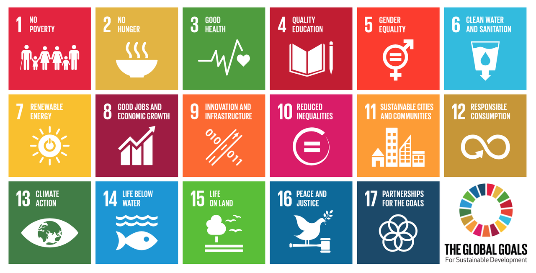
Nutrition in the Context of the SDGs
Development Agenda endorsed by all nations of the world in 2015 at the UN General Assembly
GOALS (17)
TARGETS (169)
INDICATORS (230)
Nutrition is critical to achieving this agenda!

Slide 12
Thank you!

