Slide 1
Nutrition for Health Embracing our Namibian Food Systems
Slide-Set
3 of 4

Slide 2
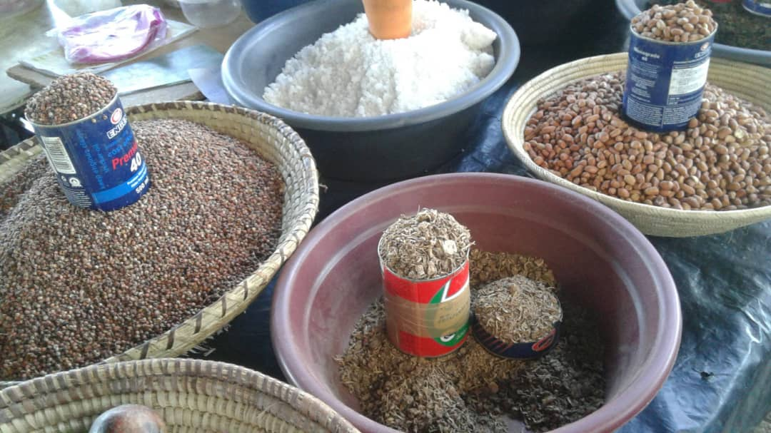
Nutrition for Health Embracing our Namibian Food Systems

Slide 3
The Right Start for our Children

Slide 4
Notes:
The image of a pregnant woman (1) highlights how human development starts in the womb, as embryos already start adapting right after conception to their environment. For instance through what the mother eats, drinks, and what and how she feels. Especially toxins (alcohol, cigarettes, etc.), malnutrition and high stress levels play a major role and increase risks of disorders and diseases. The first ‘0’ shows the importance of breastfeeding (6 months exclusively, and continue until 2 years). The second ‘0’ emphasises the importance of complementary feeding = food in addition to the mother’s milk after 6 months, as the child transitions to eating solid food, first with support and later on their own. The third ‘0’ highlights how nutrition as a central component for development supports children to successfully stand and walk ‘on their own’ when they are provided with good nutrition, positive stimulation, protection, loving care, empathy, and opportunities for play during these first 2+ years of their life

Slide 5
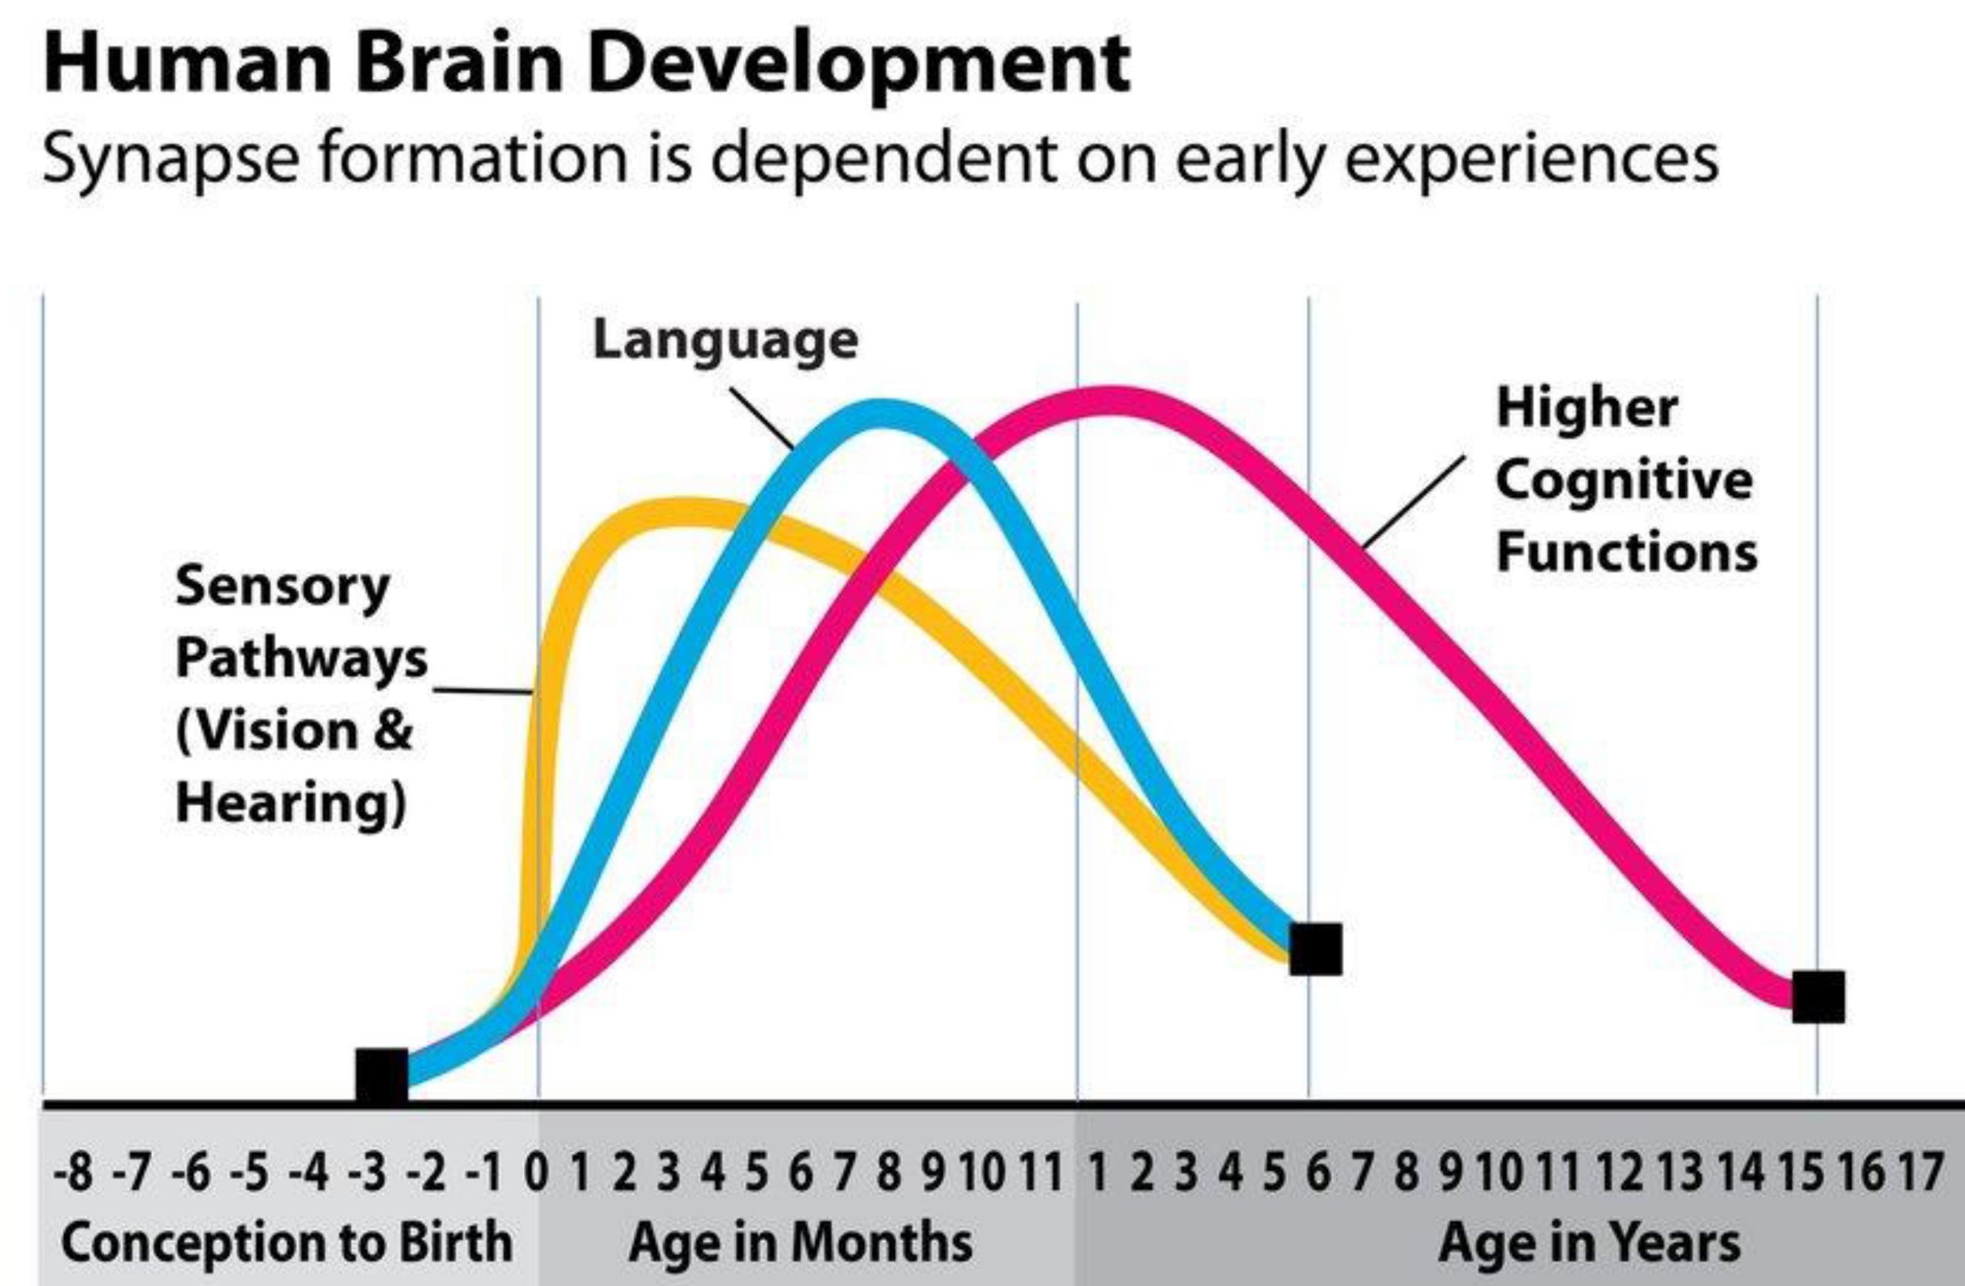
Notes:
The first 8 years in the life of a child are called ‘the formative years, as these are the key years for our physical, mental (cognitive), emotional, and social development. The first 1,000 days = from conception until the age of 2 years, is when the foundation is built, with nutrition playing a central role in this, for the human brain to develop, as shown on the chart. Explain aspects of vision, hearing, language and cognitive development as necessary

Slide 6
Notes:
Who knows the Right Start Campaign? Integrated Early Childhood Development (IECD) has been recognized as extremely important for Namibia’s national development, including aspects of nutrition. This is why the Right Start Campaign was established by multiple stakeholders in 2020. The Right Start Campaign website contains plenty of useful information and documents: www.rightstart.com.na

Slide 7
Maternal Nutrition: Exercise 5
Notes:
Exercise instructions: pp. 34-35 in the Manual, and Workheet on pp. 83

Slide 8
Notes:
FAS causes permanent (non-reversible!) physical and cognitive problems for the developing baby Babies with FAS may have smaller heads, delayed growth, abnormal facial features, and intellectual problems with learning and memory. It can be devastating, both for the affected child and for their family, and such babies often require specialized care. There is no safe amount of alcohol that a pregnant woman can consume, as any amount of alcohol can harm the developing fetus. Pregnant women must avoid drinking alcohol entirely. Smoking during pregnancy also harms the baby by decreasing the amount of oxygen and nutrients it gets, reducing growth and increasing the risks of various future health problems. Pregnant women who smoke have an increased chance of giving birth prematurely, delivering babies with low birth weight, experiencing stillbirth, and having infants who develop sudden infant death syndrome (SIDS). Babies born to mothers who smoked during pregnancy are at a greater risk of developing respiratory infections and

Slide 9
Breastfeeding and Complementary Feeding:
Exercise 6
Notes:
Exercise instructions: pp. 36-38 in the Manual, and Workheet on pp. 84

Slide 10
Notes:
Benefits for babies: help protect against infections and diseases, reduce the risk of sudden infant death Drink water/tea + different types of breastfeeding positions: cradle hold, cross-cradle hold, side-lying

Slide 11
Notes:
Key components only found in breast milk: antibodies, hormones, white blood cells, enzymes and more. Breastfeeding should be promoted, and consumers must be protected from false or misleading marketing or advertising of formula milk as pretending to be as good as, or even better than the original breast milk. In some limited cases however, the use of formula can be useful indeed. Yet, in many cases there are ways in which mothers can continue using their own milk, e.g. pumping of milk when having to go to work

Slide 12
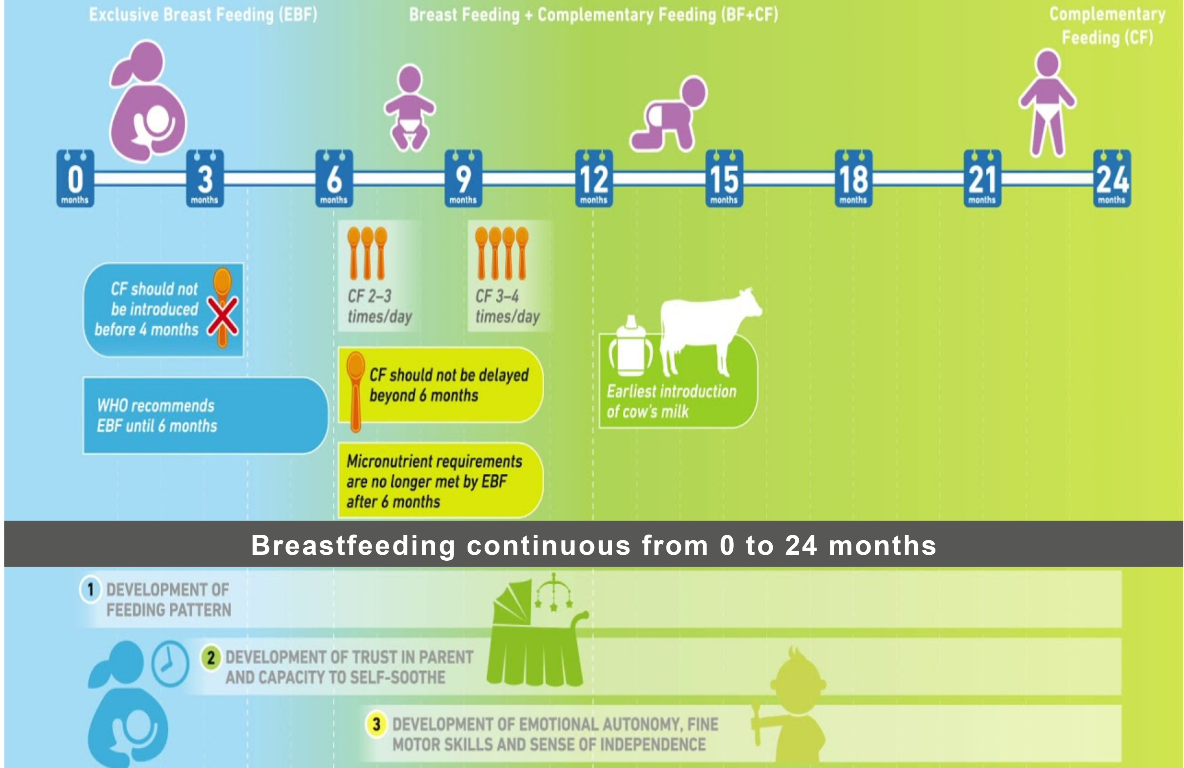
Notes:
Complementary feeding should start at 6 (six) months, while some start already at four months, it should not be delayed beyond 6 (six) months. Benefits of complementary feeding: build strong immune system, support growth and proper development Type of food to be eaten during the complementary phase (start with iron-fortified infant cereal – thin mahangu and oats and gradually introduce family food – mashed bananas, carrots, pumpkin, fish, chicken No sugar and no salt – to reduce the risk of developing health problems such as Diabetes and hypertension later on in life. It also helps to limit the child from developing a sweet tooth and salty cravings.

Slide 13
Child Nutrition
…and more

Slide 14
Notes:
Children need to eat and drink healthy for proper growth, better immune systems, and smarter brains Healthy eating and drinking habits are formed at an early age. Avoid giving them too much sugar early on, and rolemodel healthy eating and drinking habits, as well as other positive behaviou

Slide 15
Notes:
State how your choices for your children determine their future health and lifestyle. Provide and ask for examples of unhealthy eating/drinking practices and their consequences. Encourage practicing healthy eating habits from an earlier age. Give and ask for positive examples. Limit the use of electronics for small children and be aware of what they are watching

Slide 16
Notes:
Encourage mothers (and fathers!) to take their children to health facilities for regular check-ups for immunization, micro-nutrient supplementation Micro-nutrient supplementation that children under five in Namibia need are Vitamin A and Iron, according to national guidelines. Other supplements can include zinc, iodine, and folic acid. Regular de-worming should also be considered, as parasites are common and hinder nutrient intake. Health professionals should also measure weight, height and overall growth and make notes in the child’s health

Slide 17
Notes:
Ask participants what hygiene routines they have in place at home, such as cleaning, washing hands, brushing teeth, bathing etc. Highlight how hygienic, safe and clean conditions are important for us to be and stay healthy.

Slide 18
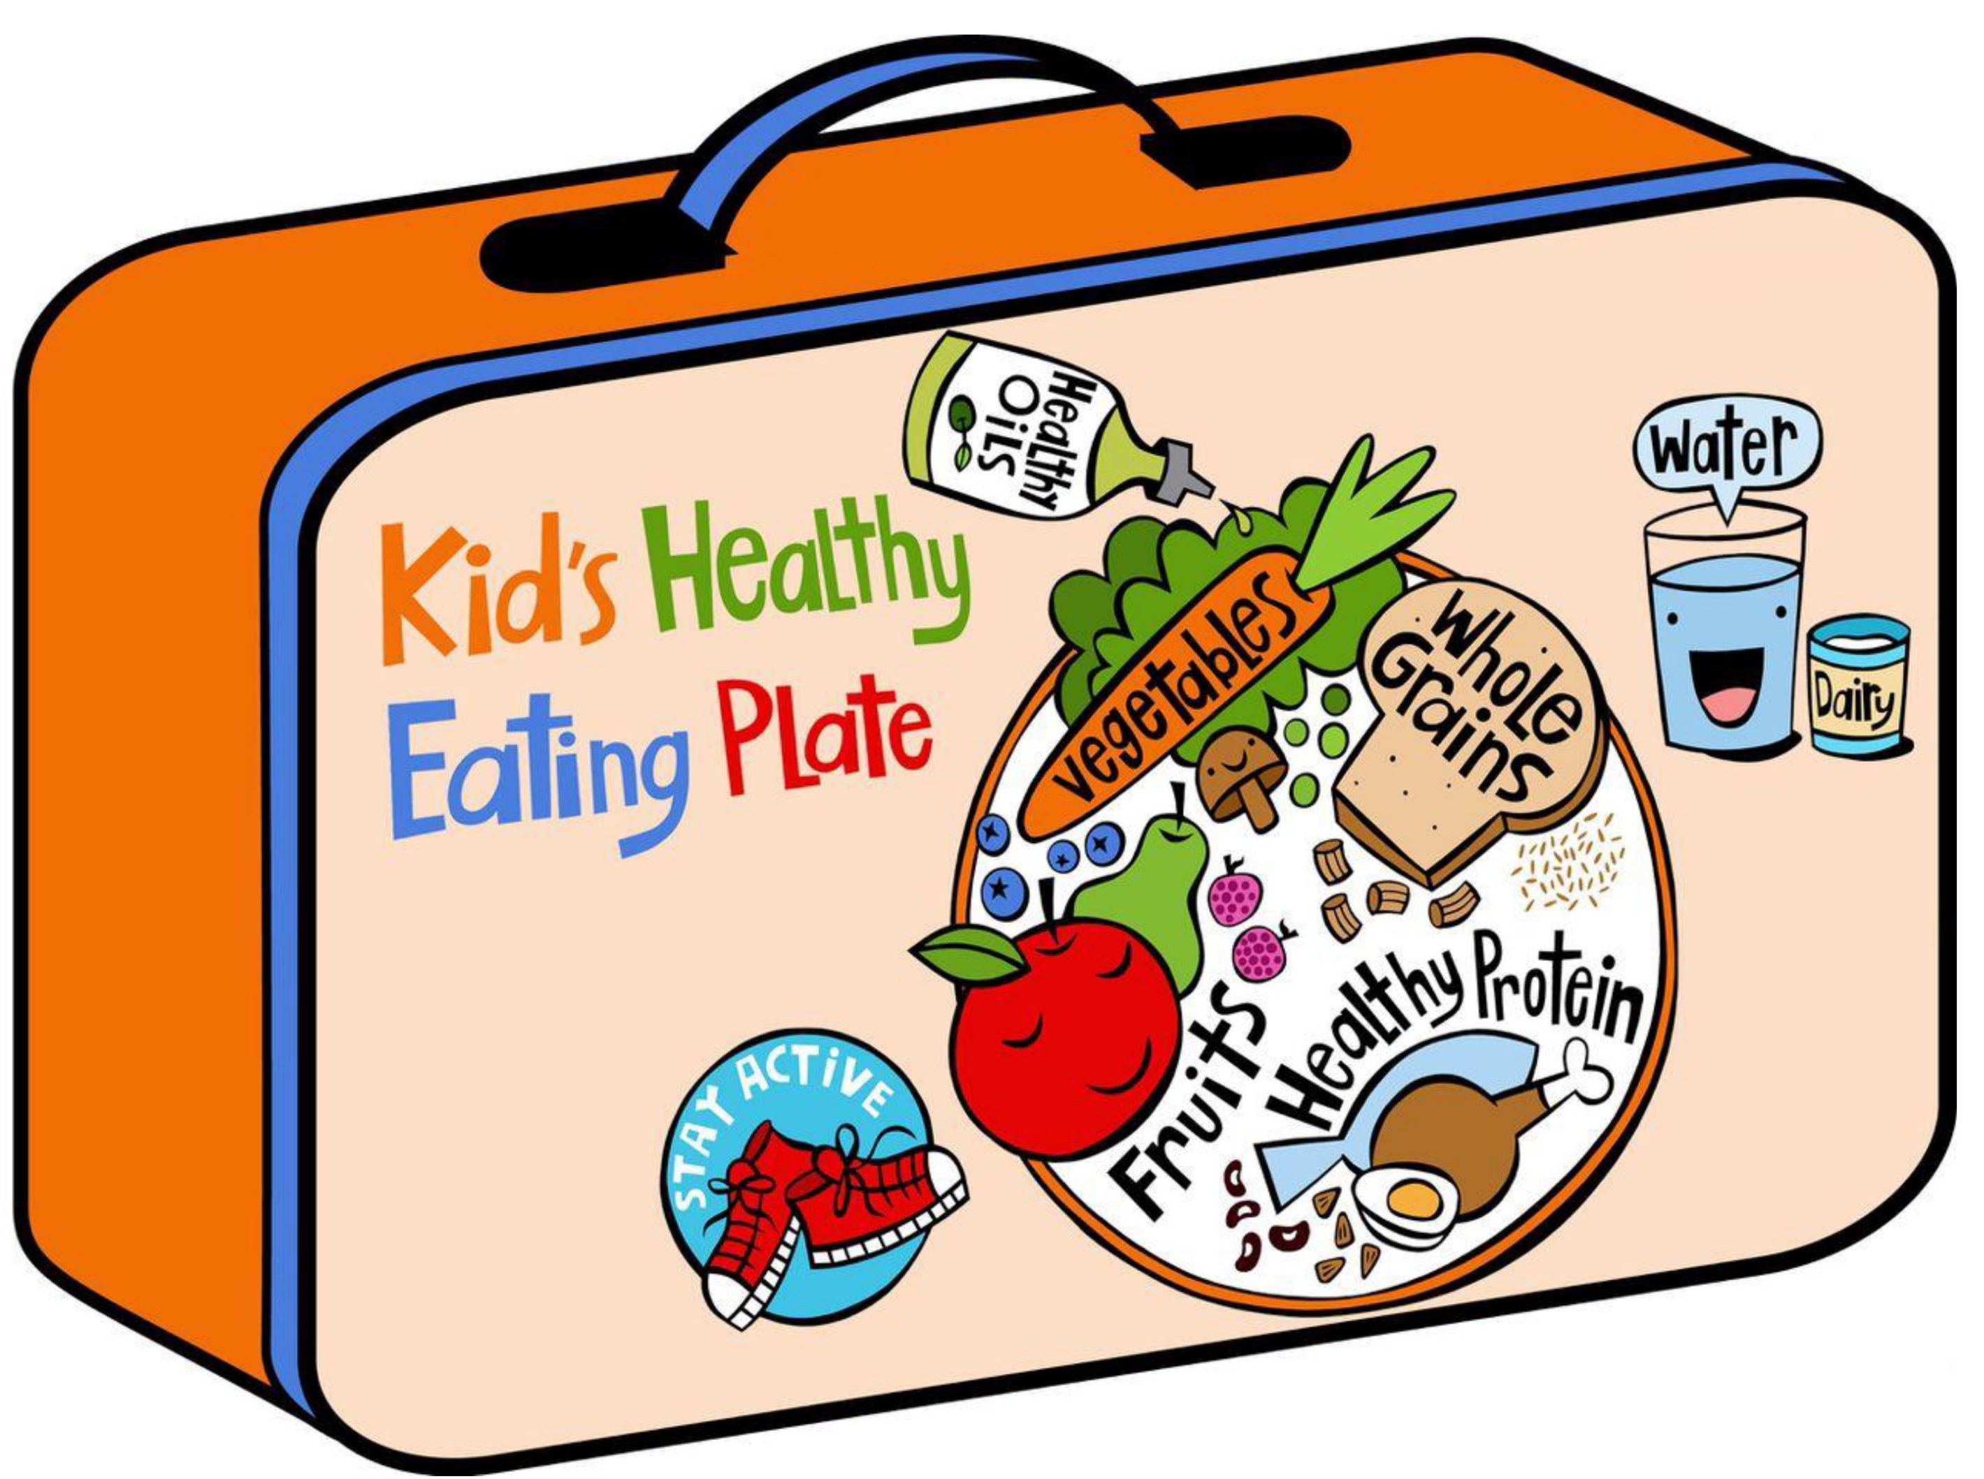
Notes:
What does your child eat at school?

Slide 19
Thank you!
More information:
www.nafsan.org/N4H

